Slide 1
Integrated Research Presentation
11th Grade Semester One

Slide 2
What should my analysis contain?

Slide 3
What should my analysis contain?
History: OPCVL
Language Arts: Rhetoric (the effect of persuasive speaking or writing)

Slide 4
History Analysis
Please see OPCVL handout.
There will be additional resources on the website as well!
Hint: Do this step before you look for rhetoric.

Slide 5
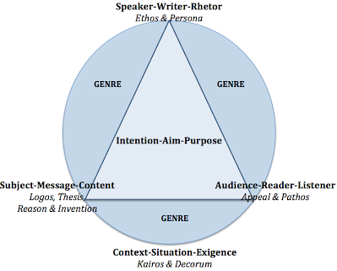
Language Analysis: Rhetoric
Identifying elements of rhetoric and persuasion for each source.
Can include...
Elements of the Rhetorical Situation
Persuasive/propaganda techniques
Some other language technique
Structure

Slide 6
Strong Analysis
LA:
Explain effect.
How does this develop a rhetorical appeal to serve purpose?
Hint: Think about how the words/images in your source connect to your language lens.
SS:
Explain value and limitations.
What can we learn about history from this document and what is missing?
Hint: Notes on Limitations that only discuss bias of origin is standard.

Slide 7
Ways you can share your analysis:
You can annotate right on your excerpts. Make your margins bigger for more room to write and annotate.
Recommended because easier and adds clarity
Consider completing LA & SS annotations separately. (print excerpt 2 times)
At a minimum, color code LA & SS annotations for easy viewing.
You can write bullet points under your excerpts.
Harder because you must clearly specify where in the source you are getting your idea from.
Have another idea? Let us know.
You must clearly distinguish between LA & SS analysis.

Slide 8
Rubric
Read through “Standard” and “Exceeds Standard”
Highlight key words.
What do you notice?
What makes the difference from one level to the next?
*Don’t forget you MUST have a work cited page!

Slide 9
Give this a score on the rubric:
Excerpt from: An Indigenous Peoples’ History of the United States by Roxanne Dunbar-Ortiz

Slide 10
Give this a score on the rubric:
Excerpt from: An Indigenous Peoples’ History of the United States by Roxanne Dunbar-Ortiz

Slide 11
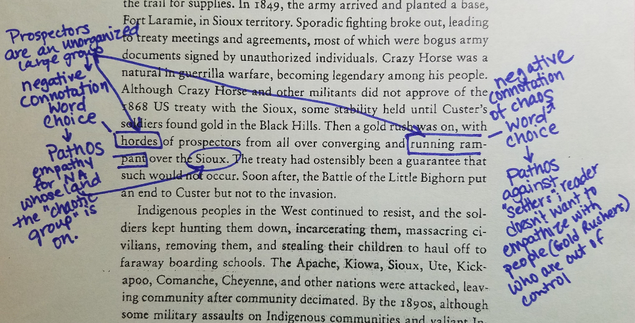
Give this a score on the rubric:
Excerpt from: An Indigenous Peoples’ History of the United States by Roxanne Dunbar-Ortiz

Slide 12
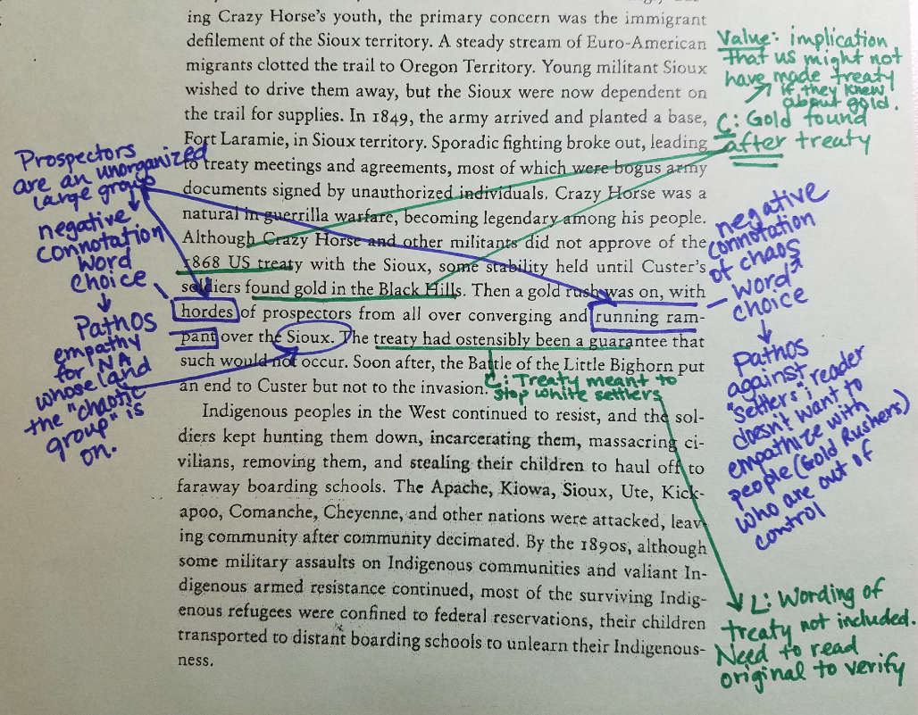
Notice:
History Analysis: Content is connected to Value and Limitations
Language and Historical analysis clearly differentiated: History analysis in green; LA analysis in blue
This sample analysis is not complete. (Missing other aspects of OPCVL and Language)
Excerpt from: An Indigenous Peoples’ History of the United States by Roxanne Dunbar-Ortiz

Slide 13
Help with
research question

Slide 14
Research
Topic Selection
Background Research
Argument Construction
Thesis
Initial Question/ Focus
Writing
Process
Analysis
Argument
Research
Research
Analysis
Focused Question
Notes:
Research is not a linear process. It’s messy

Slide 15
Research
Topic Selection
Background Research
Argument Construction
Thesis
Initial Question/ Focus
Writing
Process
Analysis
Argument
Research
Research
Analysis
Focused Question
Notes:
Research is not a linear process. It’s messy

Slide 16
Research Question
Initial Research Question: How was the Freedmen's Bureau depicted by the media?
Focused Research Question: To what extent did the negative media coverage of the Freedmen’s Bureau in Montgomery Alabama newspapers impact African American education in the city from 1865-1872?
Initial Research Question: How did the media promote the modern woman of the 1920s?
Focused Research Question: To what extent did 1920s Hollywood media challenge female stereotypes in their marketing of Clara Bow?

Slide 17
Focused Research Question
Debatable: Frame your question in a way that it cannot be answered by timeline of facts (e.g. “What caused the Civil War”). Consider sentence starters:
“To what extent…”
“What is the most significant impact of…”
Specific: You can narrow your focus in many ways. Consider:
Timeframe
Geographic Location
People
What is your research and analysis revealing to you about your topic? Consider how this connects to your language lens.

