Slide 1
Annotated Bibliographies
Annotated Bibliography- a list of sources that includes a summary and/or an evaluation of each source.
For this project:
- 5 sources w/ MLA citation - Each with a paragraph of annotation (Summary, evaluation, reflection of application)

Slide 2
Annotations: (7-9 sentences)
Summarize What is the main argument? What are the main points? What topics are covered? In short, what is the source about?
Access Evaluate the source. Was it useful? Is it reliable? How do you know? How does it compare to your other sources?
Reflect How does the source fit into your research? Was it helpful? How does it affect your argument?

Slide 3
Format- citations
The first entry should be one double-spaced line below the title, which should be Annotated Bibliography. All other entries should follow in alphabetical order.
Each entry should follow the standard citation format according to MLA citation style.

Slide 4
Format- Annotations
Each annotation should begin one double spaced line beneath each works cited entry.
Each annotation should follow standard paragraph format, beginning with an indentation.
Each annotation should be roughly the same length so that each entry looks uniform.

Slide 5
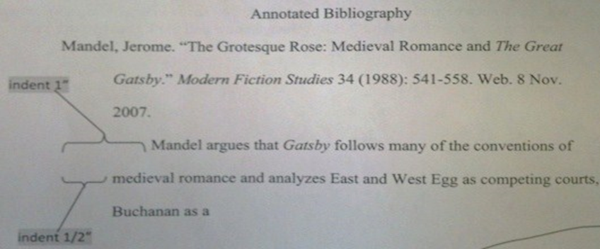
Example

Slide 6
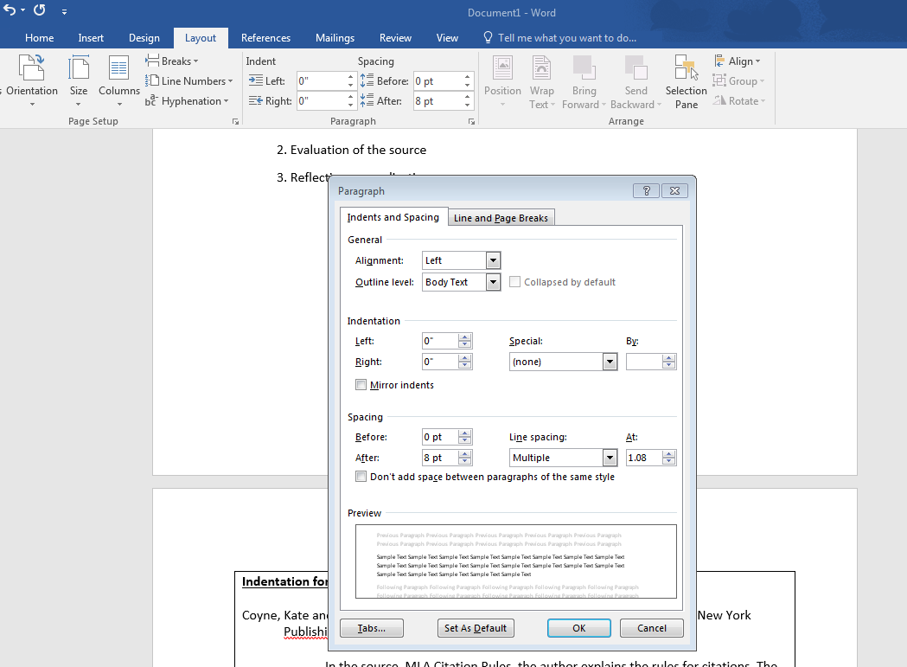
Formatting

Slide 7
How to tell if a source is credible?
Check type of source- Website? Journal? Article?
Check author- Who? Are they reliable?
Check publication date- The more recent the better!
Check bias- is it politically tied?

Slide 8
RESEARCH SOURCES
Use
Journal Articles
Primary Sources
Books (print)
Newspaper articles
Scholarly works
Articles with credible authors
Don’t Use
.com sources (most of them)
"Reviews"
REALLY old publications
Encyclopedias
Biased sources
Opinion pieces

Slide 9
Refresher: What was the assignment?
Summarize What is the main argument? What are the main points? What topics are covered? In short, what is the source about?
Access Evaluate the source. Was it useful? Is it reliable? How do you know? How does it compare to your other sources?
Reflect How does the source fit into your research? Was it helpful? How does it affect your argument?
MINIMUM OF 7 SENTENCES (7-9 sentences)

Slide 10
Alright, let’s look at a few examples of various types of responses. Examine each to see what may be weak and/or what may be strong about the analysis.

Slide 11
Examine the analysis of sources below:
….This source has lots of examples from different events.
….It’s reliable because its from a .org site.
….It is reliable because it has an author and is from a database.
….It is reliable because it was published not to long ago.
….It good source. Lot of info.
….I found this…
What did we notice?

Slide 12
Examine the analysis of sources below:
…This source is reliable because the author is a distinguished professor from the University of Massachusetts and his article was published in a reliable online accredited journal within the past five years.
….This article further expanded on aspects of the Argentinian Genocide such as the hardships faced by the indigenous people of Argentina and the reasons why Roca, specifically, believed genocide to be a necessary and valid action.
….This source provides useful tools for the reader to grasp a better understanding of the context through the use of visual political and topographical graphs, tables, and statistics.
What did we notice?

Slide 13
A few pointers from Ms. Magee & Ms. Bassett
When you are summarizing and evaluating the source ask yourself the following:
Is this source reliable just because it has more than one author? I should dig deeper.
Okay, this is a reliable source. How do I prove HOW and WHY it is reliable?
Am I using DETAILS? (Saying it “gives a large amount of information” is vague)
How will I use this source in my research? Or will I?
What else do we need?

Slide 14
So, what do we expect?
TOMORROW: Peer Review and Edit in Ms. Bassett’s class
You must individually go back through your annotated bibliographies and determine whether or not your annotations are up to standard.
We are expecting your peers to be strict and thorough examiners. They are there to give you constructive feedback so you can improve your writing abilities.
EVERY bibliography we looked at has room for improvements.
Do not assume that you do not need to change anything just because you may have received 15/15 on your draft. If you submit it again as is, you will not receive full credit.

Slide 15
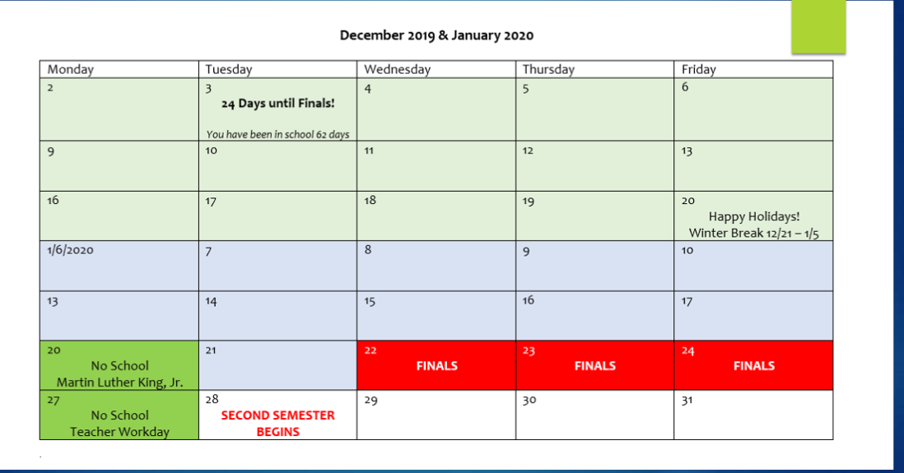

Slide 16
Although we are disappointed….

