Slide 1
7 Critical Reading Strategies
http://www.salisbury.edu/counseling/new/7_critical_reading_strategies.html

Slide 2
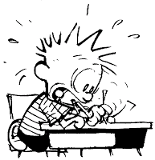
What most of us feel ☺

Slide 3
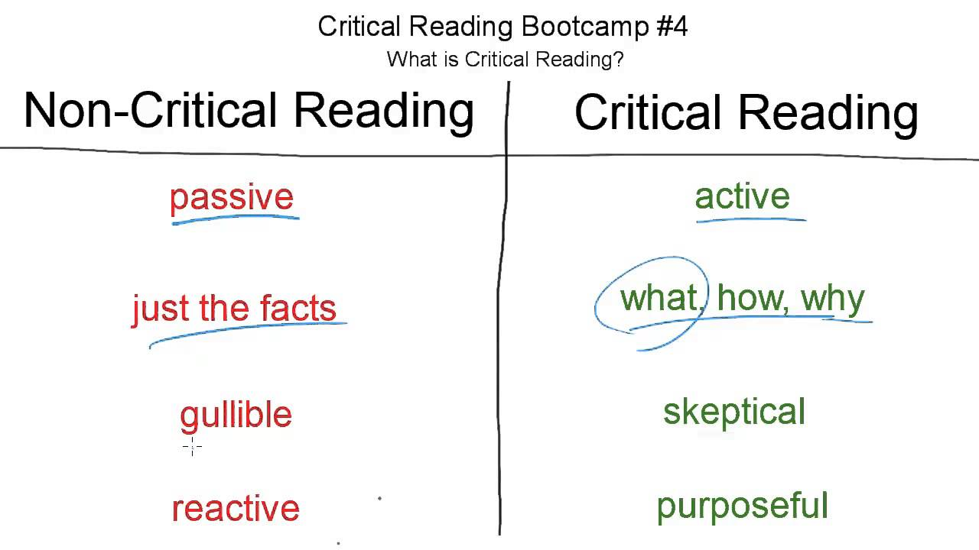

Slide 4
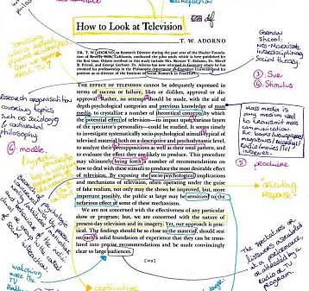
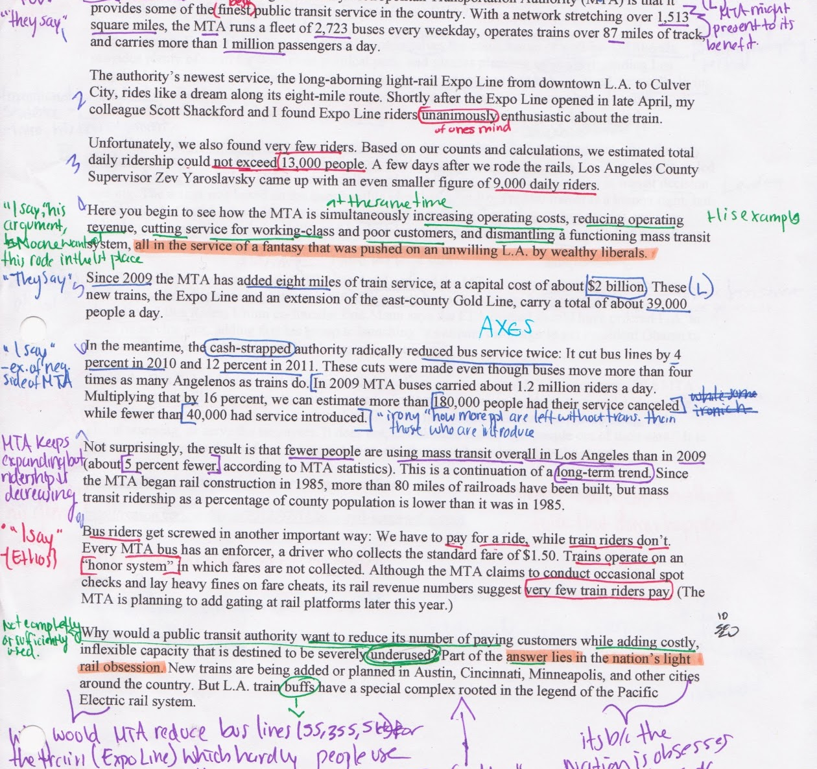
What we think Teachers are looking for
Yes, this would be lovely for every time I ask for critical thinking; however, if it doesn’t mean anything to you, then what good is it?

Slide 5
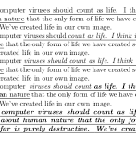
But it needs to be more than…

Slide 6
I. Begin by Previewing (Thieving)
Learning about a text before really reading it.
Get a sense of what the text is about and how it is organized.
See what you can learn from headnotes or other introductory material,
skimming to get an overview,
and identifying the rhetorical situation.

Slide 7
II. Contextualizing
Placing a text in its historical, biographical, and cultural contexts.
When reading a text, you read it through the lens of your own experience.
Recognize the differences between your contemporary values and attitudes and those represented in the text.

Slide 8
III. Questioning to understand and remember
Asking questions about the content.
When you need to understand and use new information it is most beneficial if you write the questions.
Break it down: write a question for each section.
Focus on a main idea and use your own wording (don’t copy from the reading).

Slide 9
IV. Reflecting on challenges to your beliefs and values
Examining your personal responses.
Mark an “X” in the margin at each point where you feel a personal challenge to your attitudes, beliefs, or status.
Make a brief note in the margin about what you feel or about what in the text created the challenge.
Now look again at the places you marked in the text where you felt personally challenged.
What patterns do you see?

Slide 10
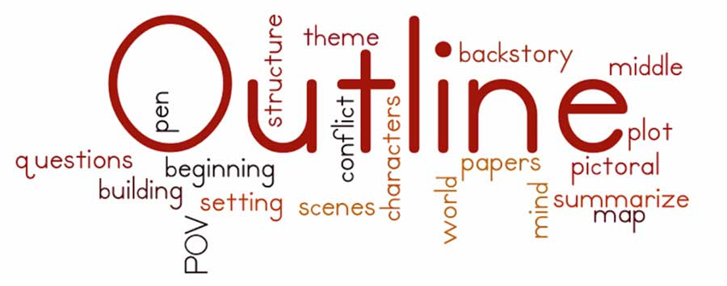
V. Outlining and Summarizing
Identifying the main ideas and restating them in your own words.
Helpful strategies for understanding the content and structure of a reading selection.
Outlining
Distinguish between the main ideas and the supporting ideas and examples.
Main ideas form the backbone
Use your own words

Slide 11
V. Outlining and Summarizing (continued)
Identifying the main ideas and restating them in your own words.
Helpful strategies for understanding the content and structure of a reading selection.
Summarizing
Form a new text using your own words
A condensed form
Requires creative synthesis

Slide 12
VI. Evaluating an Argument
Testing the logic of a text as well as its credibility and emotional impact.
Do not accept anything at face value but carefully evaluate the text.
Look for:
The claim that the writing wants you to accept.
An idea, an opinion, a judgment, or a point of view
The support that give readers the basis for accepting the conclusion
Reasons: shared beliefs, assumptions, and values
Evidence: facts, examples, statistics, and authorities

Slide 13
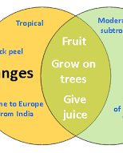
VII. Comparing and Contrasting related readings
Explore likenesses and differences between texts to understand them better.

